Slide 1
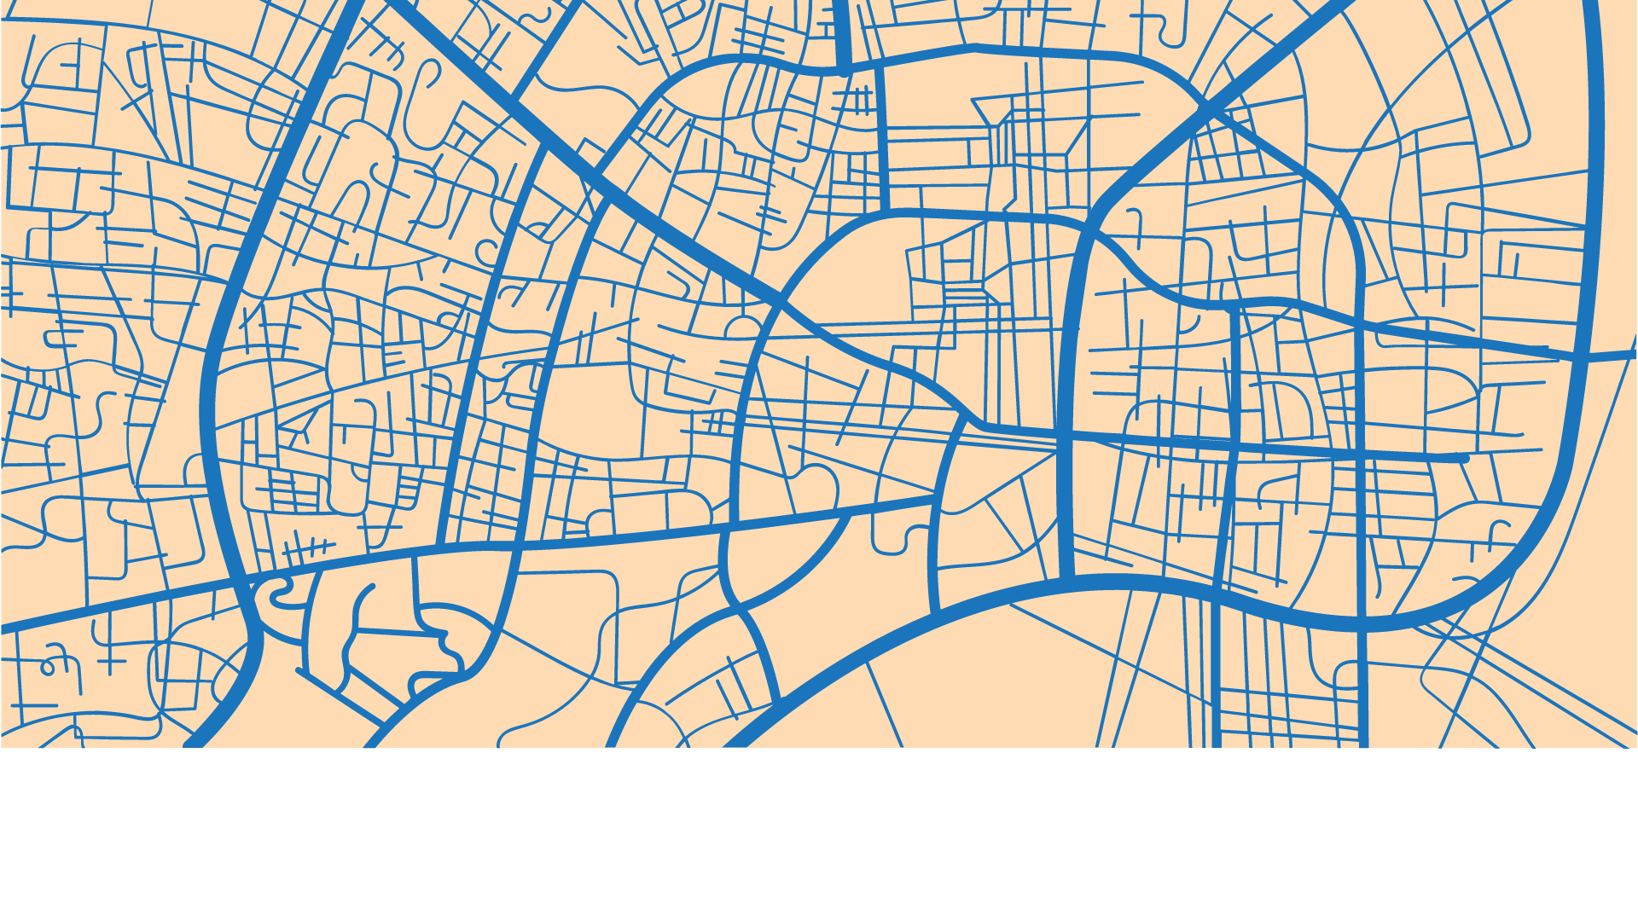
Acme Gourmet Meals Takeoff
DATASCI 205
Maria Jose Healey, Zejia Jing, Jasmine Lau, Jianyi Teng
Notes:
Hey Guys, Thank you for coming to our team’s presentation about AGM takeoff. My name is Jianyi, our team member: Maria, Zejia and Jasmine, we are glad to share our insight for AGM future development.

Slide 2
Introduction
AGM’s Future Vision
more pickup locations
using BART system
alternate methods of transportation
NoSQL Graph Databases - Business Cases
neo4j
mongoDB
redis
Notes:
In this presentation, we are go share our vision for the future of the company and discuss business cases( using Neo4j, MongoDB and Redis.)
To Address AGM’s executives vision of the future of the company, we specifically would like to:
Adding more pickup locations
Using the BART system
Trying Alternate methods of transportation
We use NoSQL graph databases to deal with above Business Cases
Neo4j
MongoDB
Redis

Slide 3
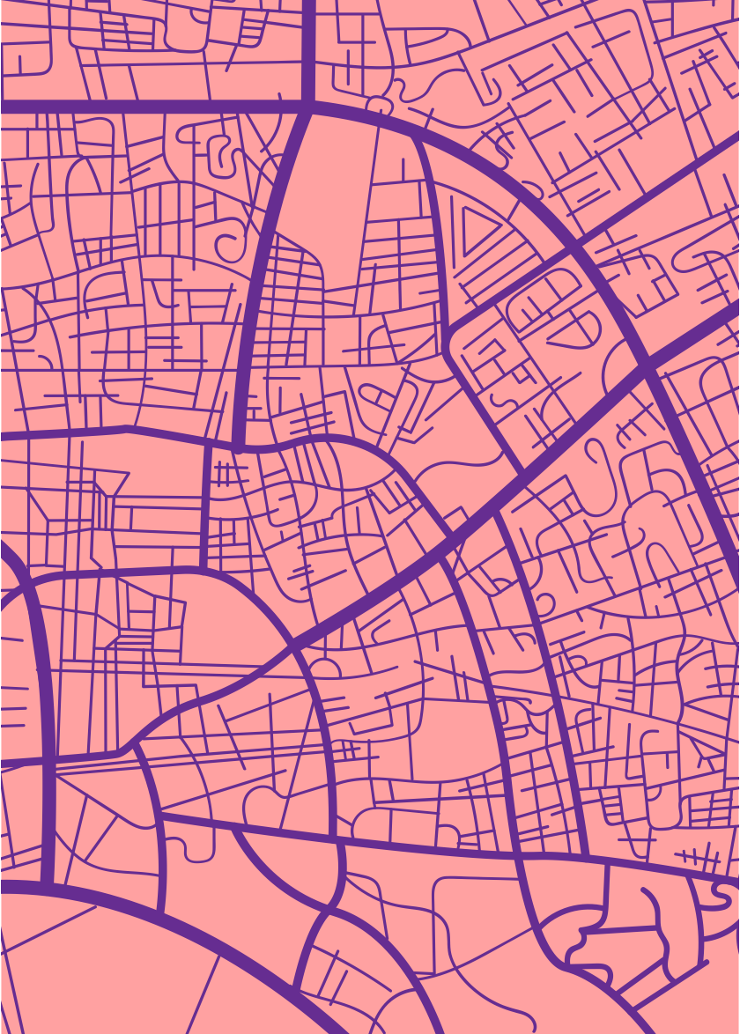
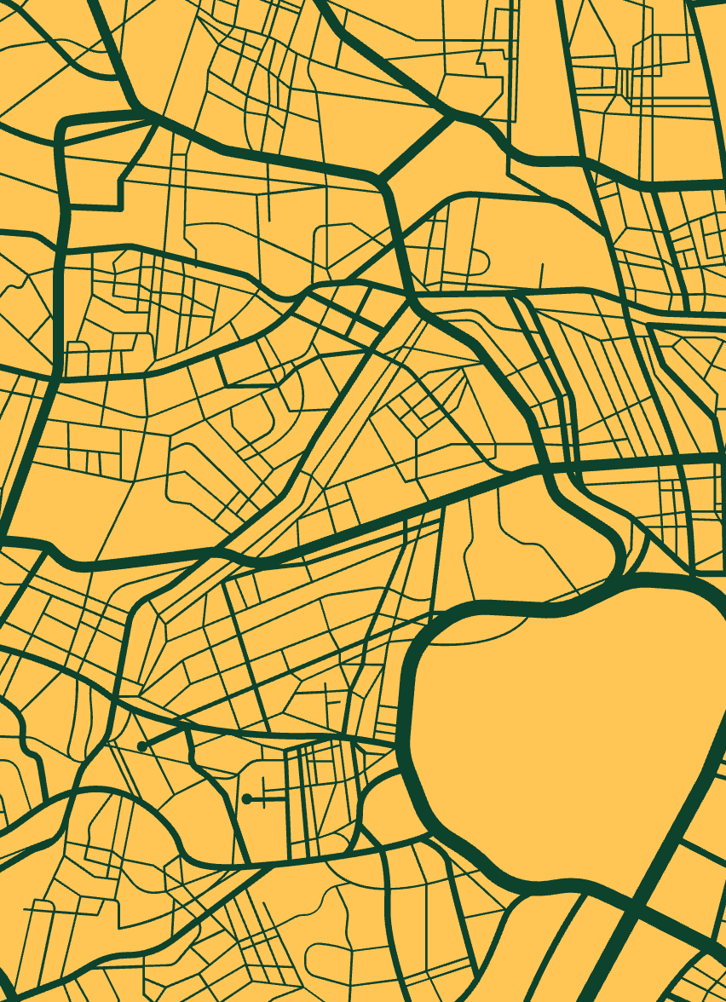
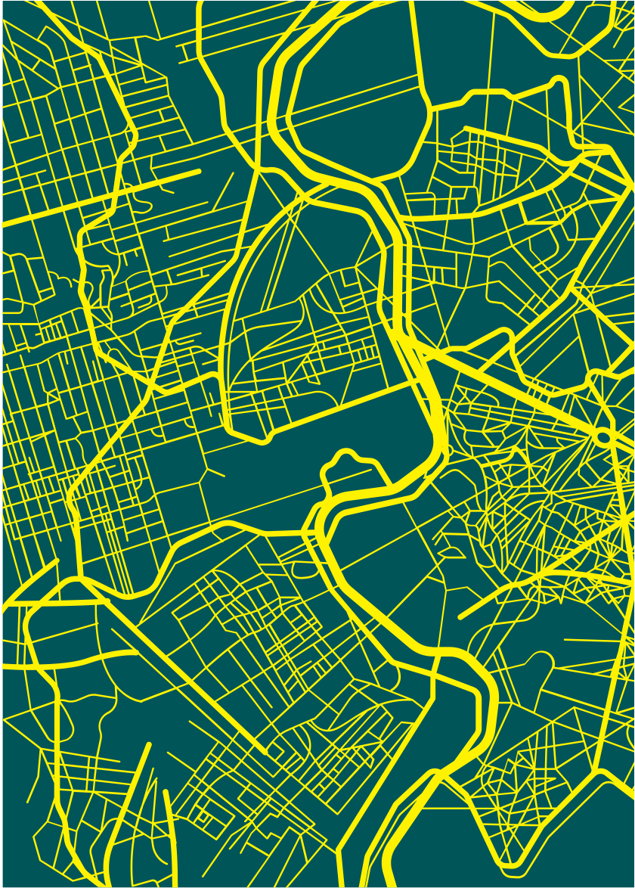
Louvain Modularity
+
Geodesic Fencing
Harmonic Centrality
Minimum
Spanning Tree
PageRank
Notes:
For Neo4j, We will go over 5 algorithms: louvain modularity, geodesic fencing, harmonic centrality, page rank, and the minimum spanning tree

Slide 4
AGM Business Cases – Neo4j
FUTURE OF THE COMPANY
New pickup locations,
faster and local delivery
WHERE
Louvain Modularity
Find community among current stations
Harmonic Centrality
Discover central stations
HOW
Minimum Spanning Tree
Find optimal routes through the system
WHY
Geodesic Fencing
Find population within 2 mi. of each station
Page Rank
Find the most influential stations
Notes:
For the future development of the company, we would like to enhance our market expansion by developing new pickup locations then supporting local delivery. To achieve this, we will separate it into 3 aspects, I will give a brief overview about them and later our team will give detail explanation for the 4 Neo4j algorithm we use : Firstly, Where (is the new pickup location), we choose LM to find community and HC to discover central stations. Then, Why (we choose the new pickup location, we choose GF to measure population and Page Rank to find the most influential location. Finally, How(we support local delivery). We choose MST to find the minimum cost for each delivery.

Slide 5
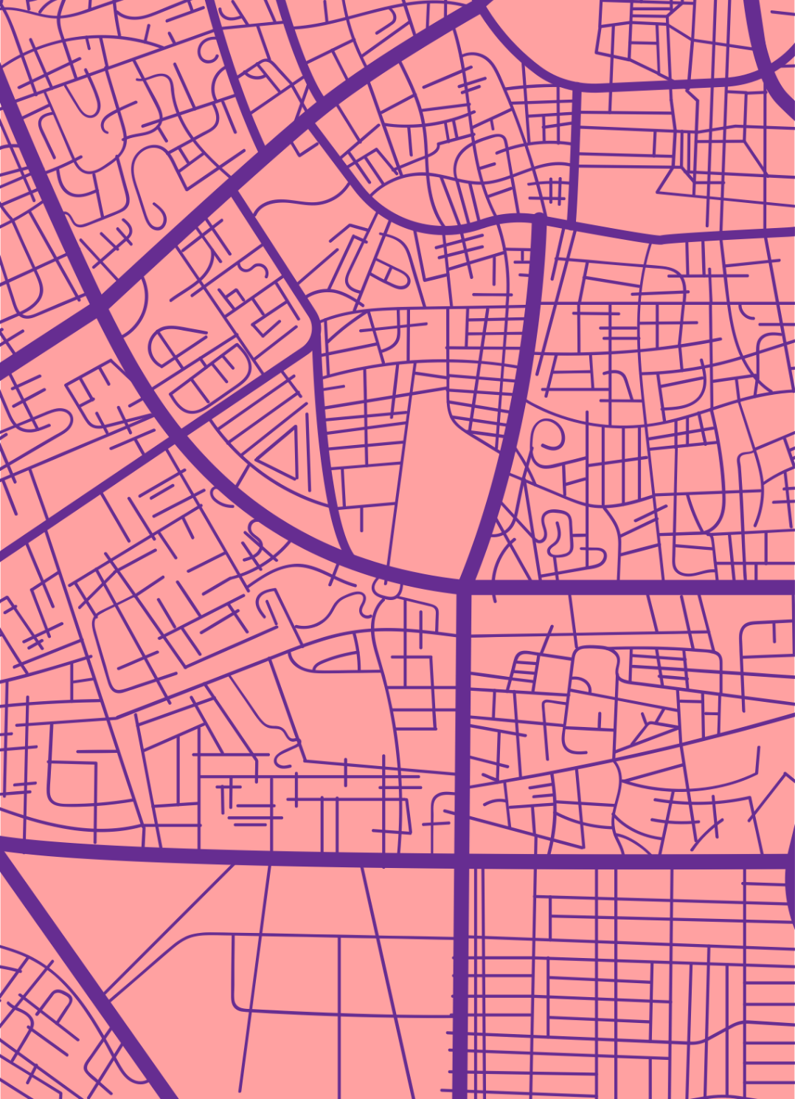
Louvain Modularity
+
Geodesic Fencing
Notes:
We will start with LM and GF, Given an background, the LM is an Neo4j algorithm that will group the nodes into community base on weights.

Slide 6
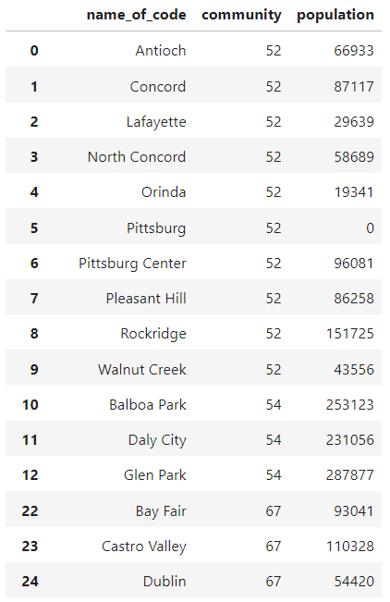
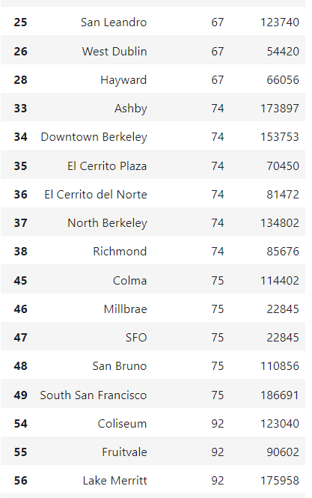
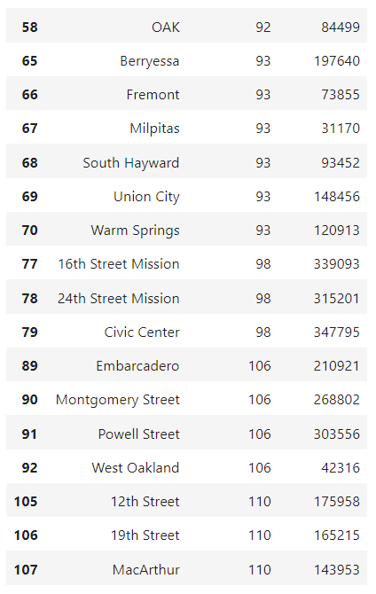
Louvain Modularity – Result Characteristics
Notes:
Here’s how we applied algorithm. To set up new pick up location, we firstly will know where to set up, then giving strong evidence to persuade business that it will bring benefit if we set up new pick up location here. That is consider an “Where” and “Why” problem. What’s shown here is the 50 different station nodes, community they belongs to, and station characteristics – surrounding population. We Applied LM to create 10 community, using the distance as weight and then calculated population within 2 miles to help with decision.

Slide 7
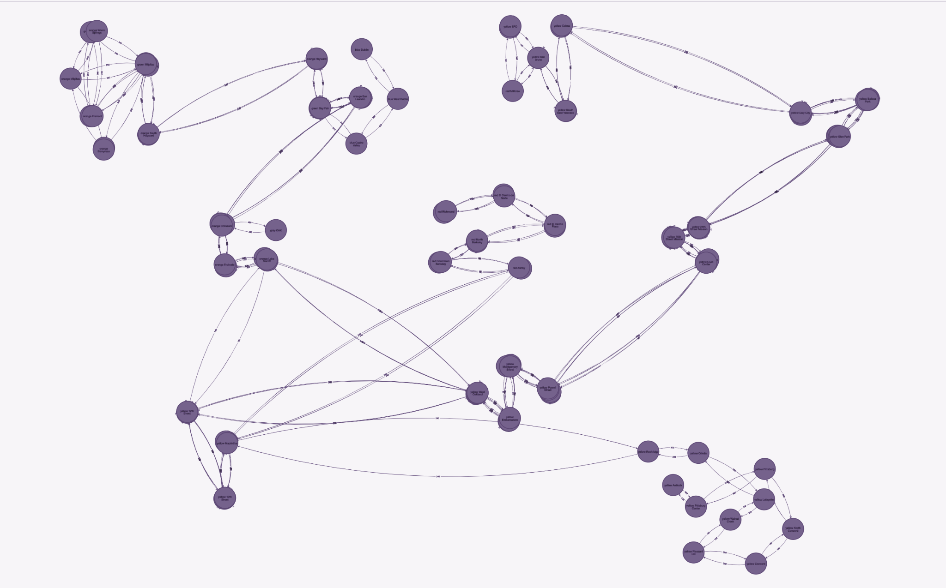
Louvain Modularity – Results
10 communities
Notes:
For the sake of business insight, we build up this visualization that it’s 50 stations has been grouped into 10 regions based on the distance (weight). Then we will calculate for each communities, what is the summarize population, to determine which communities we will pick to set up valuable new location.

Slide 8
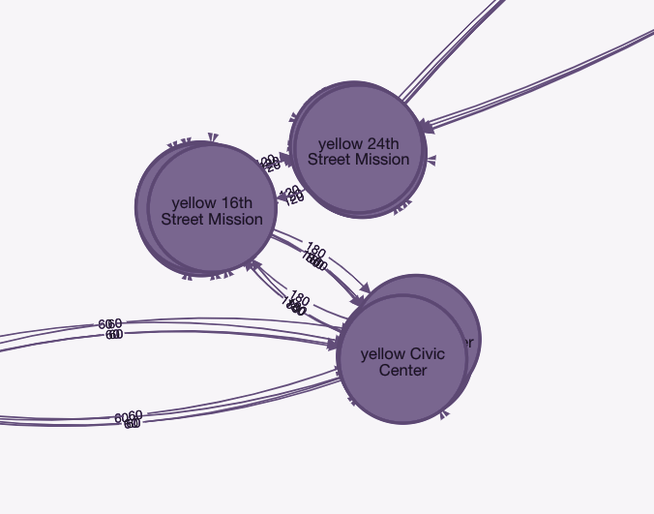
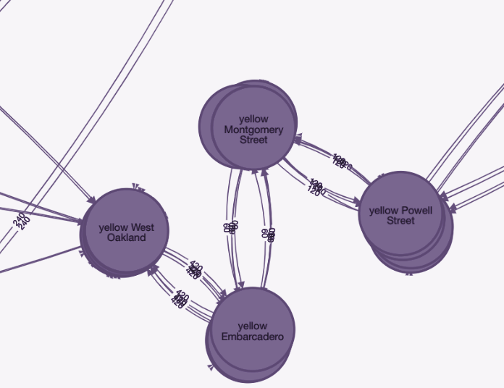
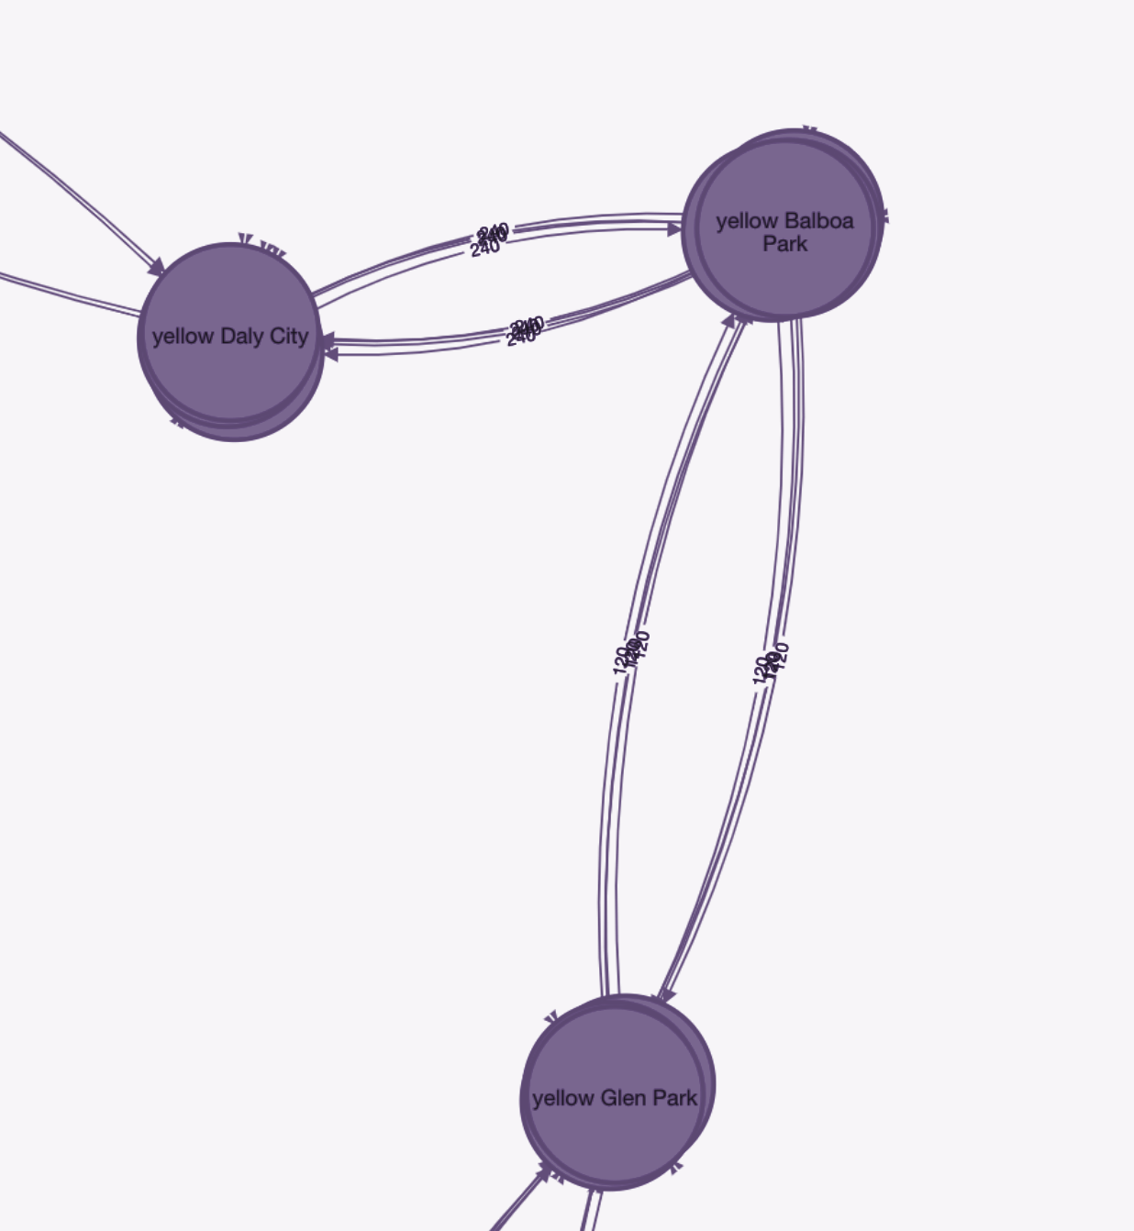
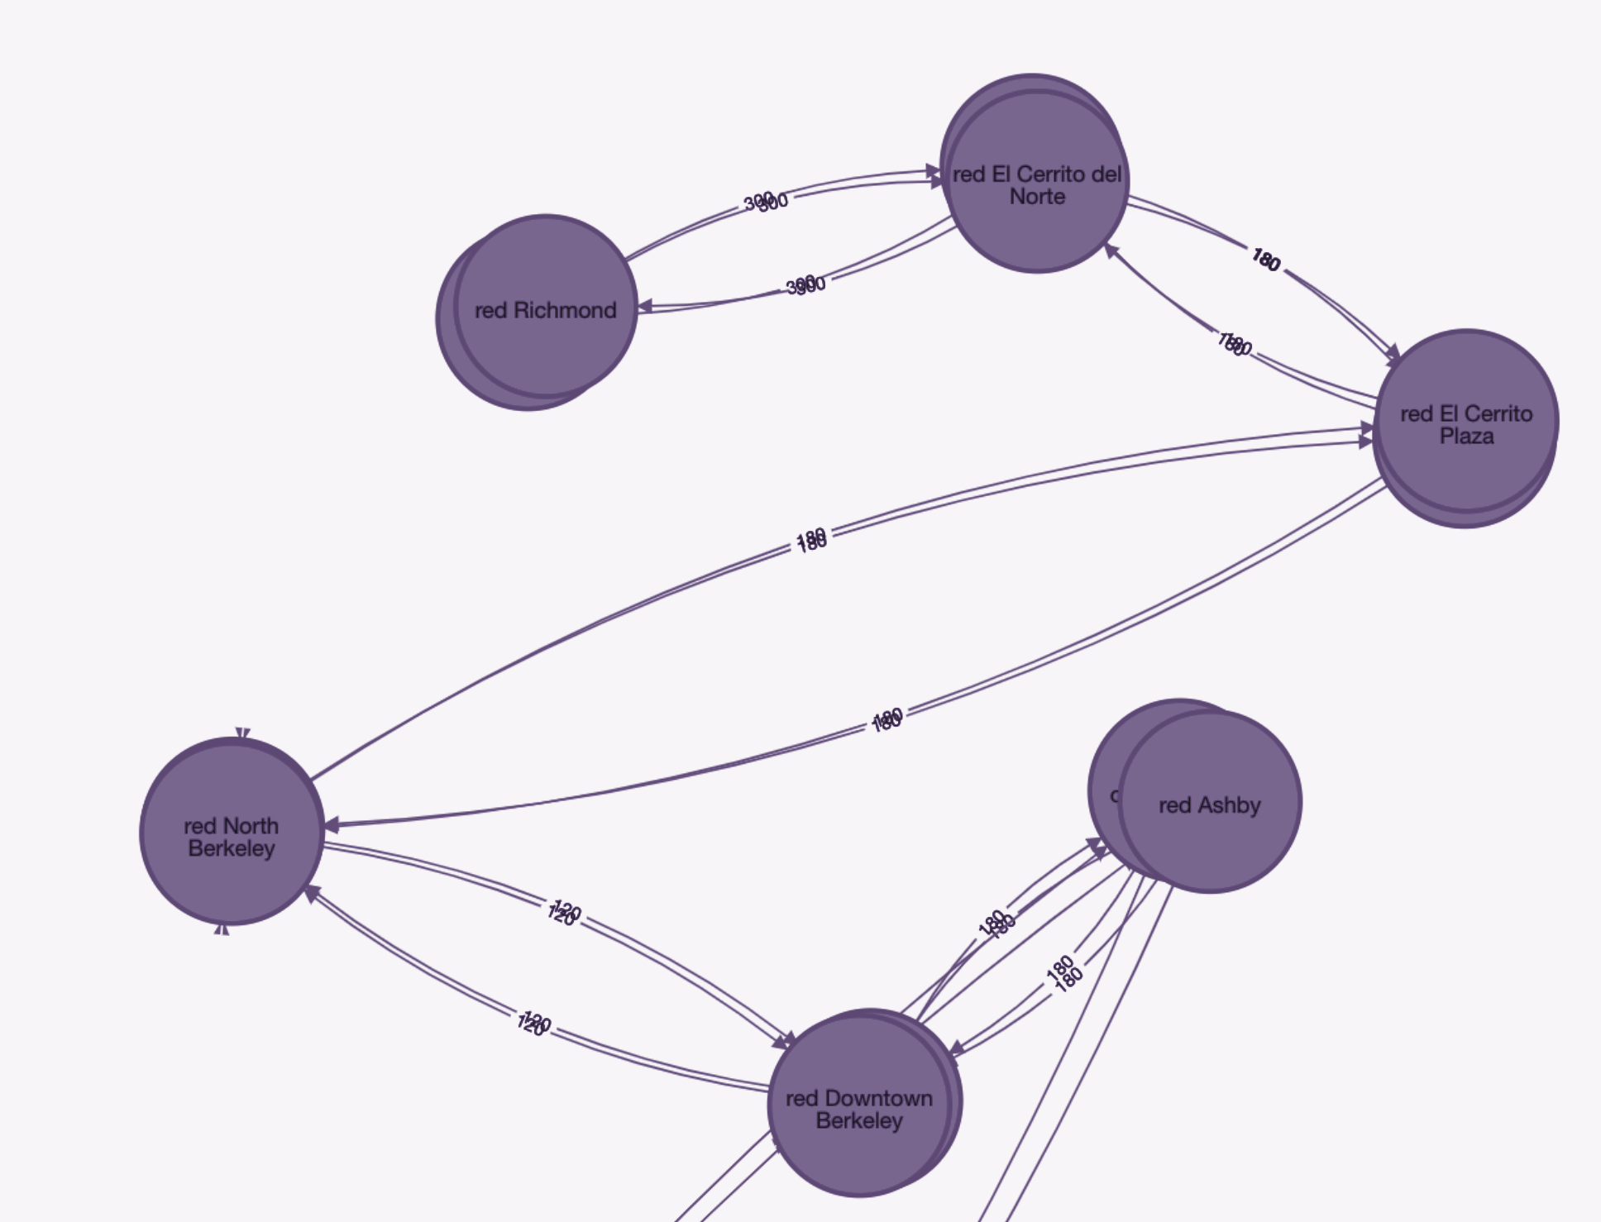
Geodesic Fencing
Population: 1,002,089
Population: 825,595
Population: 772,056
Population: 700,050
16th Street Mission 339,093
24th Street Mission 315,201
Civic Center 347,795
Embarcadero 210,921
Montgomery Street 268,802
Powell Street 303,556
West Oakland 42,316
Balboa Park 253,123
Daly City 231,056
Glen Park 287,877
Ashby 173,897
Downtown Berkeley 153,753
El Cerrito Plaza 70,450
El Cerrito del Norte 81,472
North Berkeley 134,802
Richmond 85,676
Notes:
Here, we would like to show 4 detail example- which are top 4 communities that having max population. For example, 16th, 24th and Civic center belongs to the same community 98. GF shows that there are 1 million population for the selected 3 stations. Then this area would be considered an significant place as an new pickup location. We can raise this suggestions to Business as an answer to the “where ” concerns.
Next we gonna consider another aspect of where problem using harmotic centrality. hand over to Maria

Slide 9
Harmonic Centrality
Measures shortest path between a node and all other nodes
Notes:
MJ Healey:
The harmonic centrality is a graph algorithm that measures the shortest path distances between a node and all other nodes by summing the inverses. Nodes with the highest closeness scores have the shortest distances and are able to spread information most efficiently.
In order to showcase this algorithm a NoSQL graph database was created in Neo4j to represent the stations in the BART (Bay Area Rapid Transit) system.
Next slide please…

Slide 10
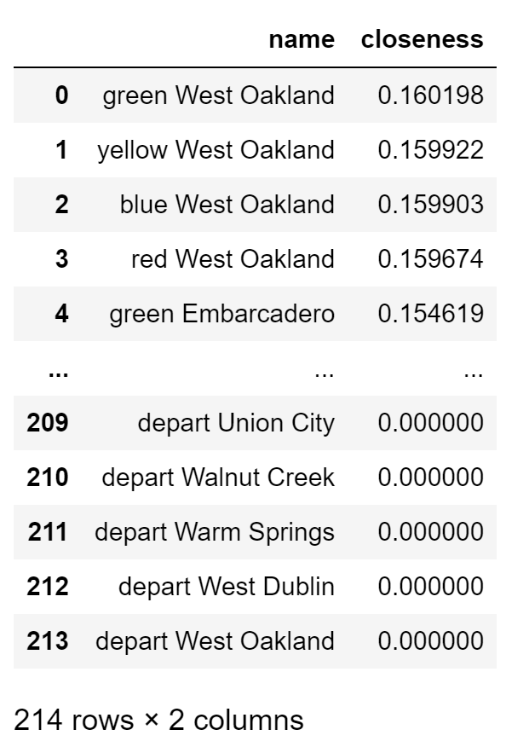
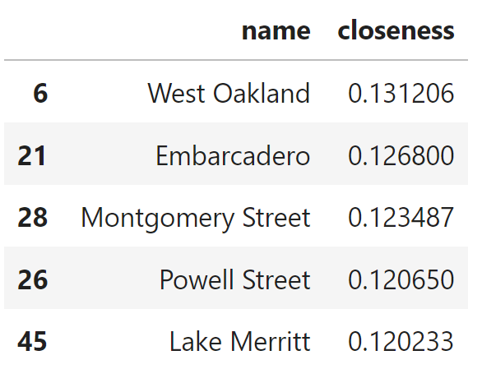
Harmonic Centrality
“To Move or Not to Move the Current Kitchen”
Algorithm Results
Consolidating Line Nodes per Station
Notes:
MJ Healey:
We wanted to evaluate if our current kitchen was in the center of the graph and whether or not we should move it. So, we ran the harmonic centrality algorithm to find the top central stations.
There are 50 stations in the BART system. However, as you can see on the left image the output of the algorithm contained 214 rows. This is because there are several nodes that represent different tracks that pass through the same station in the graph. In addition, each station had a node for arrival and departure respectively. Consequently, the results needed to be averaged to yield the top 5 central stations for consideration.
Next slide please…

Slide 11
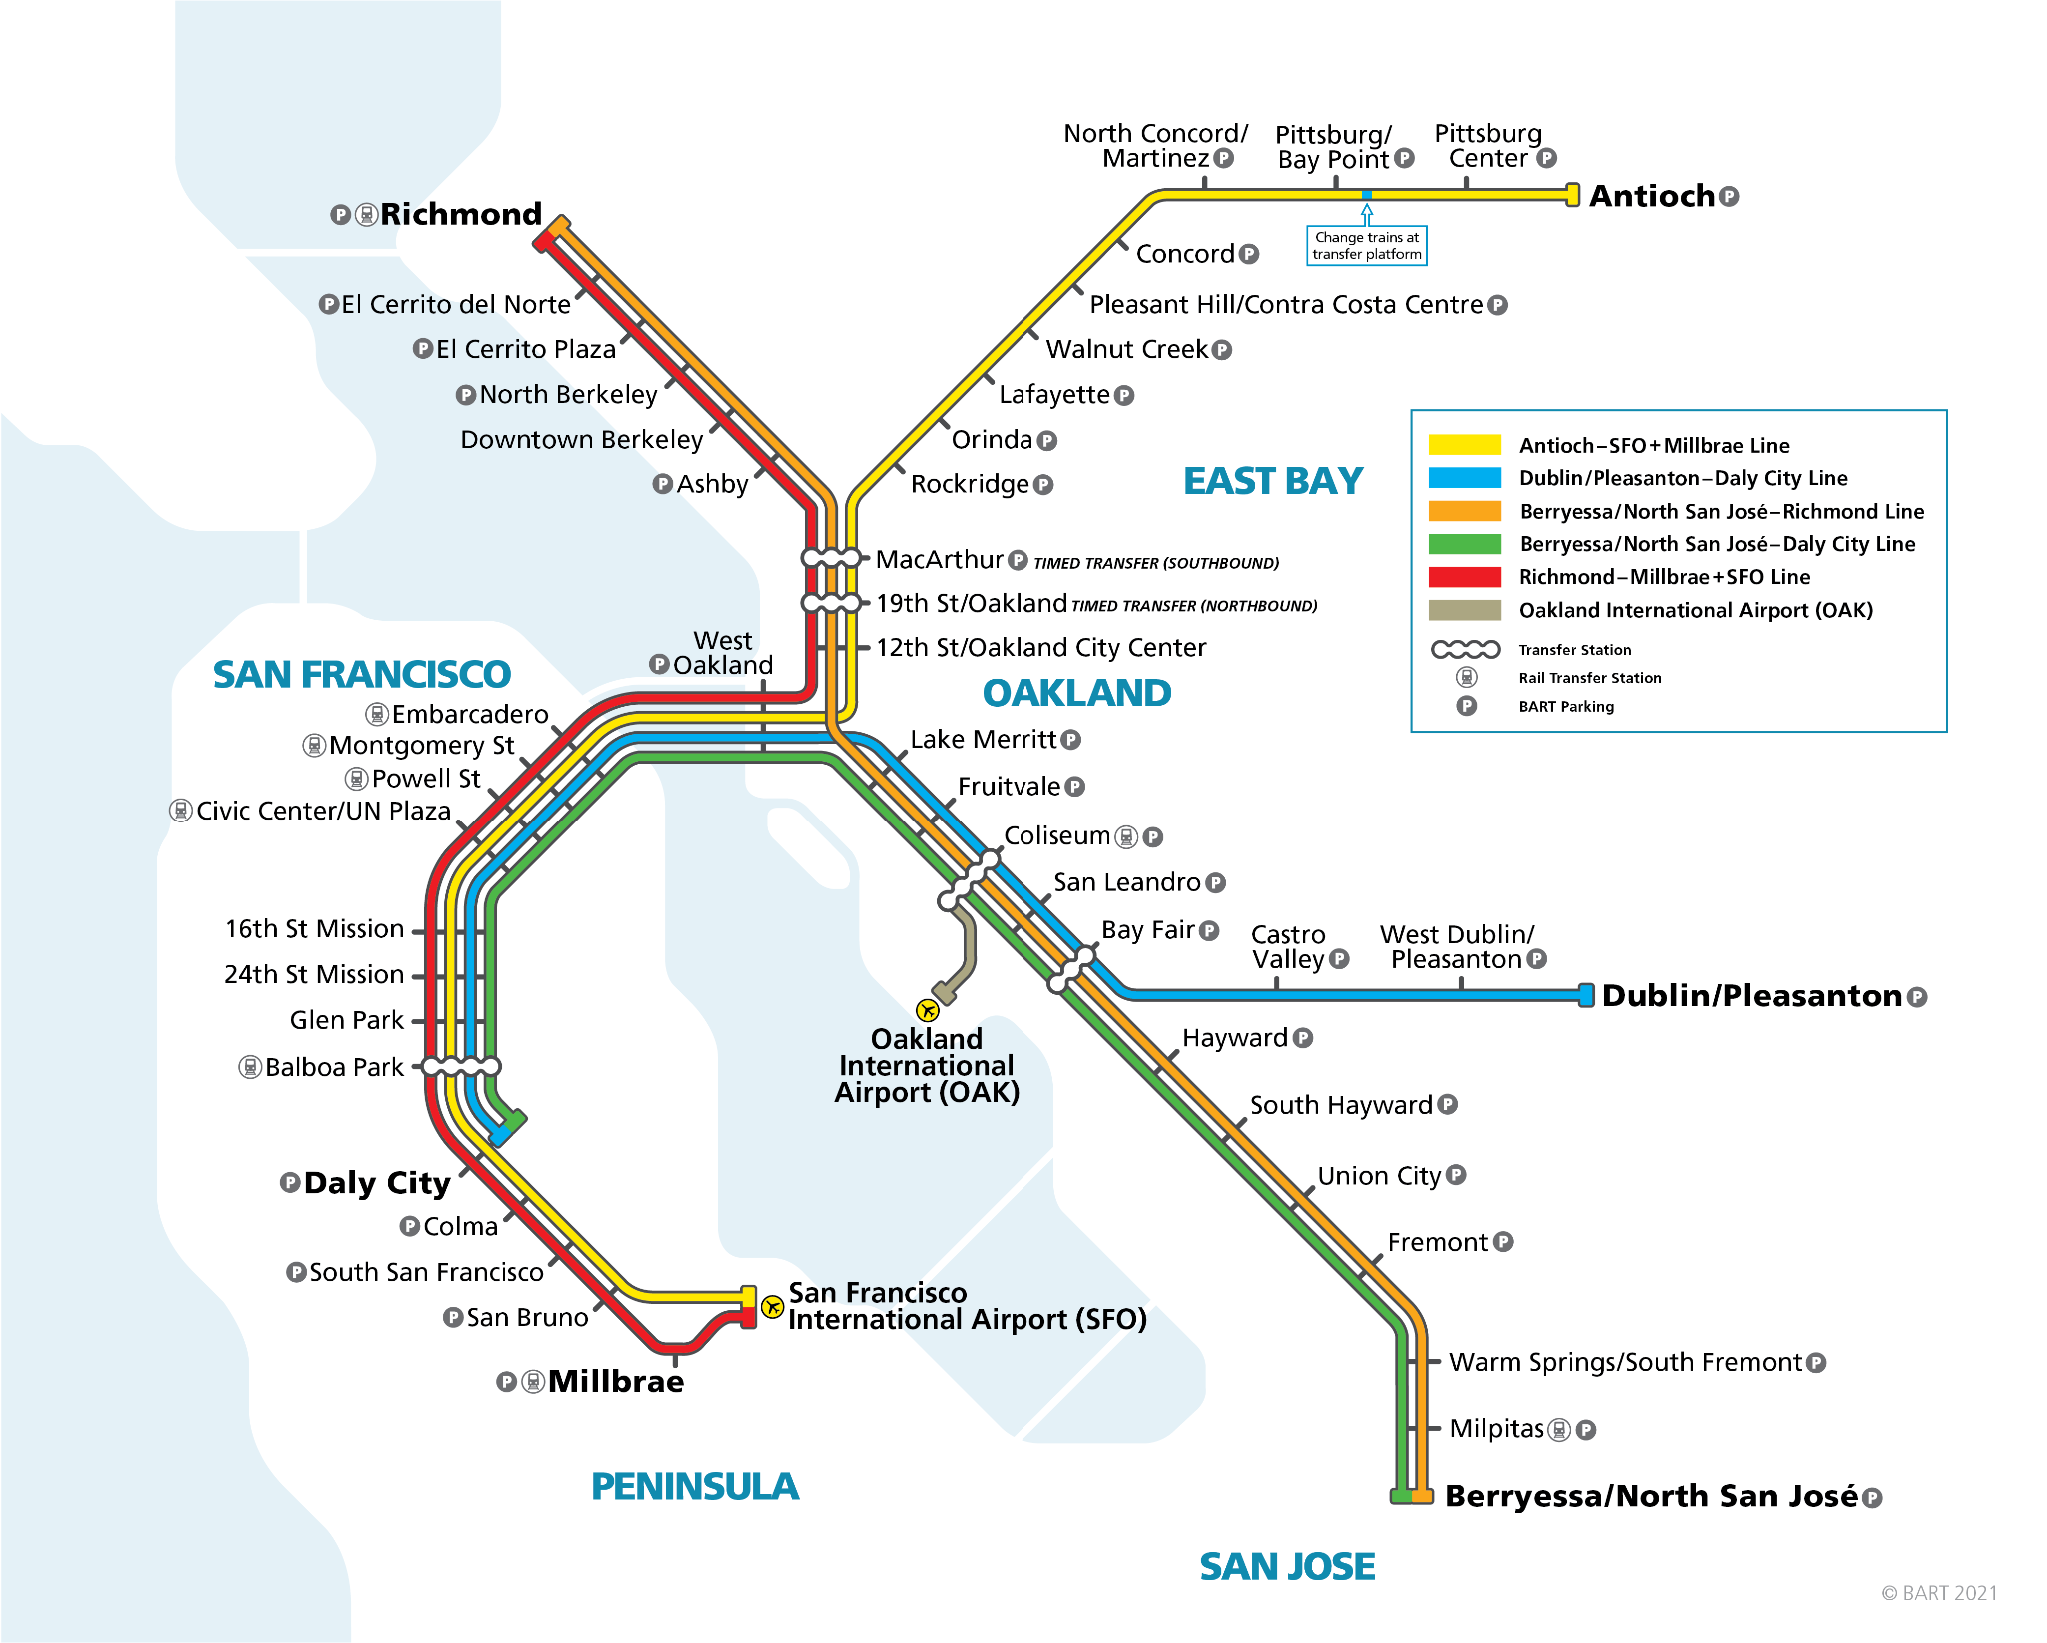
Harmonic Centrality – BART System
Berkeley Kitchen
1
5
2
3
4
Notes:
MJ Healey:
As you can observe on the BART map, the results of the harmonic centrality algorithm allowed us to see how far off our Berkeley kitchen is from the center of the graph. Additionally, we obtained 5 potential candidates for moving it. From these options, we recommend relocating our current distribution point to the West Oakland station.
Next is Jasmine

Slide 12
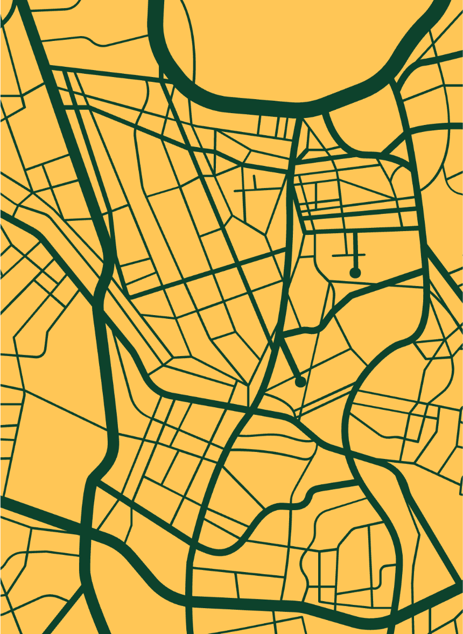
PageRank
Most influential stations
Notes:
Next, we'll discuss the PageRank algorithm for identifying the most influential stations within the BART system, with the aim of considering them as potential alternative locations for our distribution points.
The goal behind our implementation of PageRank is to achieve end to end runs within an hour.
We believe that this approach will be more beneficial compared to our current setup of a single distribution point located in the center of the BART system

Slide 13
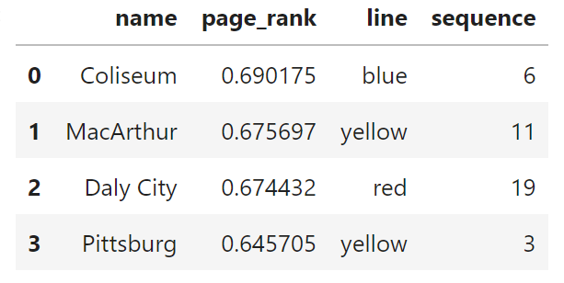
PageRank
4 stations on X-shaped BART graph
Pre-PageRank: distribution point in the center
Post-PageRank: distribution points on influential stations
Notes:
Since the BART system is shaped like an X, the stations at the endpoints of the X would be the most influential. So we decided to find the 4 stations with the highest PageRank value.
Prior to considering PageRank, our distribution was centralized at our kitchen located at the Downtown Berkeley station, positioned relatively in the center of the X-shaped system.
And now with this PageRank analysis, we would like to expand our network from having only 1 distribution point, to having 4 distribution points, ideally situated at the most influential stations.
The Coliseum, MacArthur, Daly City, and Pittsburg stations ranked highest in terms of PageRank values, making them optimal choices for additional distribution points.

Slide 14
PageRank – BART System
Berkeley Kitchen
Notes:
The Bay Fair station’ PageRank value placed it in the top 4, making it a station of interest rather than the Pittsburg station.
However, it seemed impractical to have 2 distribution points in such close proximity, the Coliseum and Bay Fair stations, so we further refined our selection process by filtering and sorting the stations to ensure that of any two stations in the top 4 have to be at least 2 stations apart.
Making the Pittsburg station, which ranked fifth in PageRank value, our 4th distribution point consideration

Slide 15
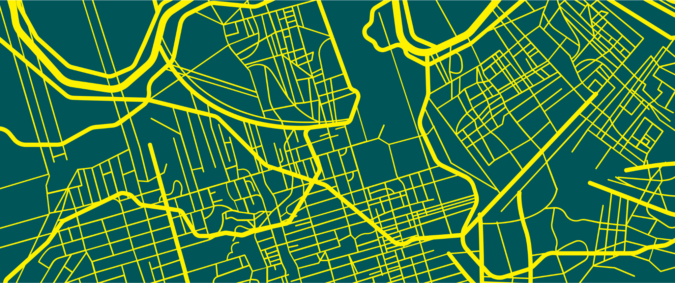
Minimum Spanning Tree (MST)
Notes:
Zejia Jing:
Minimum Spanning Tree algorithm is to Find a tree structure path that will visit all nodes in the graph with smallest cost and connects all nodes with minimum hops.

Slide 16
Minimum Spanning Tree – Uses
BART
Drones – pick up at station and deliver locally
Robots – pick up at station and deliver locally
Not BART
Drones – pick up at additional center and deliver locally
Robots – pick up at additional center and deliver locally
Notes:
Zejia:
First let me talk about the business case using Minimum Spanning Tree to address two of executives vision of the future of the company:
Using BART for transportation and then let drones/robots deliver locally
Delivery drones/robots pick up deliveries at the BART station and deliver them locally.
Adding pickup locations that are NOT at BART stations
Delivery drones/robots pick up deliveries at an additional pickup location and deliver them locally
In this business case, Minimum Spanning Tree will be used to give each zipcodes the shortest path to the bart station. Minimum Spanning Tree would also give us the least total distance that the robot/drones could possibly have to route.

Slide 17
Minimum Spanning Tree
Zip codes within 2 mi. of Downtown Berkeley
Nodes and edges of graph
Distance between nodes
edge weight = distance
Notes:
I use three steps to create neo4j graphic database. In this example, I will use zipcode within 2 miles of downtown berkeley as an example.
Find all zip codes within 2 mile of the Downtown Berkeley station
Create the departure/arrival nodes for each zipcodes and stations and also create non-directional weighted relationships among those nodes in the graph
Calculate the distance among nodes. Assign this distance as their relationship weight in the graph

Slide 18
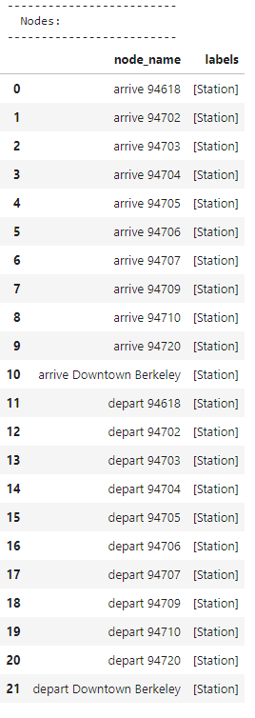
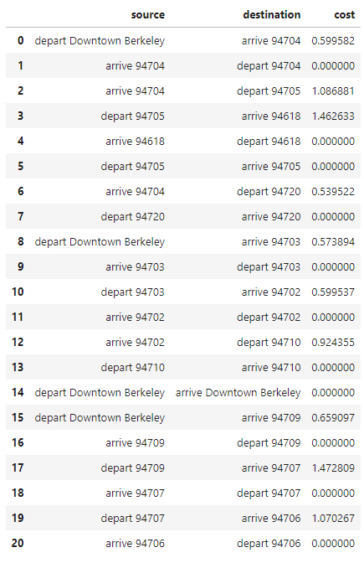
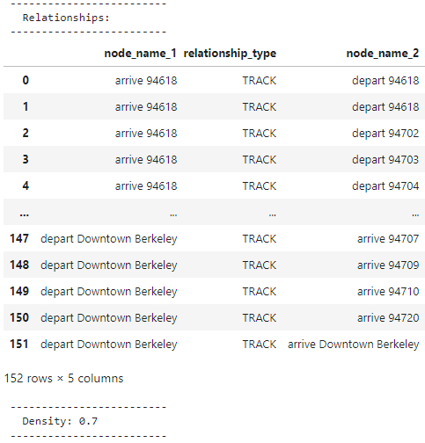
Minimum Spanning Tree – Nodes, Edges, Results
Notes:
Here is the screenshot of the result of neo4j graph database I created.
It is a 22 nodes, and 152 relationships graph neo4j database. By running the built in minimum spanning tree algorithm, it will give us the tree structure with the least total costs on the right screenshot.

Slide 19
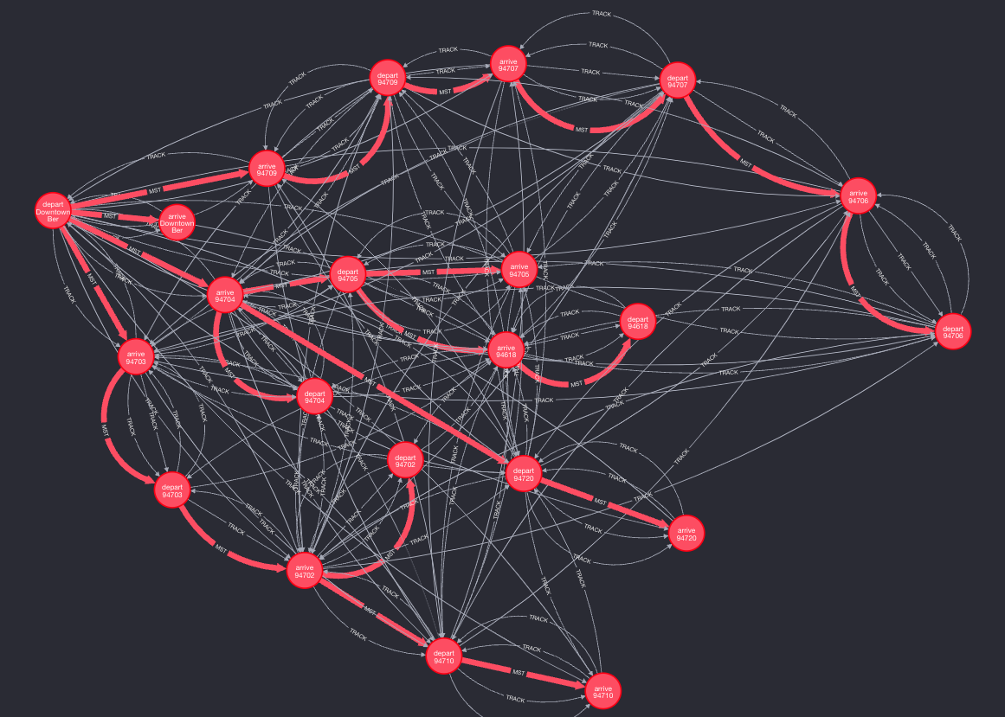
Minimum Spanning Tree – Results
Delivery within 2 miles
of kitchen:
3 routes for drones and robots
add non-BART pick up locations at intersections
Notes:
Business suggestions:
●Use three drones/robots/trucks that deliver to each branch of the MST tree which will guarantee the minimum delivery time to local within 2 miles of berkeley downtown stations
●Add possible non-BART station pick up points at those intersection points will make the local delivery more efficient.

Slide 20
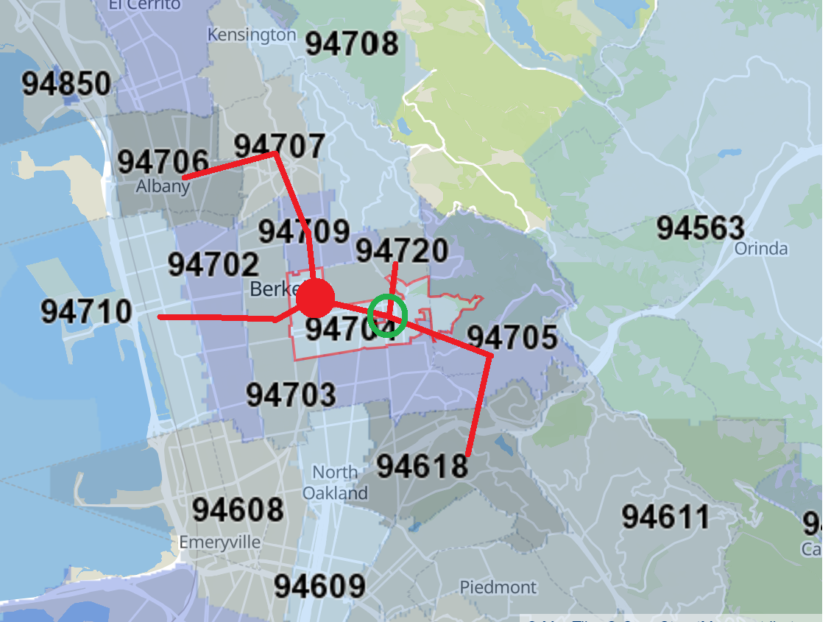
Minimum Spanning Tree – Map
BART Station
Intersection
potential new pickup location
Notes:
Zejia:
Here shows the zipcode map. From this map, we can use the result from Minumum spanning tree to draw the best local delivery route in red lines. The Berkeley Downtown station is shown in the red circle. There are three branches source from the red circle berkeley station . That means, Using three robots/Drones and let each robot/drone travel each branch might give the best delivery efficiency. Besides, we might consider add additional not bart station pickup location at the intersection point in green circle, so that those sub branches growing from those intersection point will be able to be delivered from a much nearer pickup location.

Slide 21
MongoDB
Document Database
Using alternative methods of delivery
Drones
Electric Vehicles
Accelerating customers logins
Notes:
MJ Healey:
MongoDB is a document database that stores data as JSON-like documents. Unlike SQL that requires data to be normalized across tables, Mongo can store data for a use case all in the same JSON record, which can be particularly helpful when you want to do large scale analytics.
Mongo would be a great option to store delivery operations data if the company decides to employ other modes of transportation like drones, and electric vehicles. For example …

Slide 22
MongoDB - Business Cases
Managing electric delivery vehicles in BART system
pre-compute shortest paths from kitchen, and store them
mongoDB – faster when querying + ability to scale up
Live traffic report
POVs show stations, customers, products, and vehicles affected
mongoDB – flexible schema + stored data format
Faster customer login
manage broad range of data operations
relational DB – pull from many tables → ↑ login time
Notes:
MJ Healey:
It would be energy-efficient to pre-compute all single shortest paths from the Berkeley kitchen and store them in Mongo. This information would be crucial to manage delivery vehicles that require battery charge.
Mongo is the better choice to store this information over a traditional relational database because of the speed that it provides when querying the database and the ability to scale up.
Mongo is a great option to store live traffic issues that are known in advance like construction zones . Multiple points of view could be created to show the stations, customers, products, and vehicles affected. They could also be used to communicate the rerouting times.
In this case, Mongo is better suited than a relational database because of its flexible schema and the format in which it stores data.
MongoDB would also be a great option to help accelerate the login process for customers. This would be critical to avoid losing customers as the company grows.
If a relational database were to be used in this situation, a login would take a long time because SQL would need to pull information from different tables.

Slide 23
Redis
Real-Time Tracking of Delivery Drones and Robots
Continuously send coordinates and updates for routing and scheduling

Slide 24
Redis – Features
Pub / Sub, Lists, Sorted Sets
real-time messaging
In-Memory Database
low latency, high throughput
Geospatial Toolset
query objects based on geography
Clustering
scalability, data redundancy
Notes:
How Redis can be used to solve that business example. Our primary requirement in this business case is speed and handling high volumes of simple read/write operations with geographic data in real-time
Redis supports Pub/Sub, Lists, and Sorted Sets, which are useful for real-time messaging between drones and control systems.
Redis, being an in-memory database, offers low latency and high throughput. It can process thousands of messages per second, making it ideal for real-time applications.
Redis provides geospatial /ˌdʒiəʊˈspeɪʃəl/ data toolset with its sorted set-based geo API, which can store, update, and query objects based on geographical location efficiently.
Redis supports clustering which spreads data across multiple nodes, providing both scalability and data redundancy. Reids can have a scale out with millions of users, and if we build a big enough cluster with enough memory on each node in the cluster, we can have millions of users who get the Redis data immediately which will help our customers real time tracking their delivery by drones.

Slide 25
Database – Drawbacks
Performance Issues with Real-Time Data
traditional DB – not optimized
relational DB – struggle with volume
Geospatial Queries are Complex
relational DB – less efficient and need plugins
Scalability Concerns
relational DB – scaling → adding servers
Notes:
Now let me explain why a relational database would not be a good fit for this business example
First is because of Performance Issues with High Frequency, Low Latency Requirements in real-time data:
relational databases are not optimized for the kind of high-speed, real-time read/write operations needed for tracking hundreds or thousands of drones.
Relational databases might struggle with the high volume of transactions due to disk-based storage systems, leading to slower response times and costly in terms of performance. That is for real time data, Relational databases take a long time to query. Redis can pull it out very quickly.
Second is because of Complexity in Handling Geospatial ˌdʒiəʊˈspeɪʃəl/ Queries:
Redis provides geospatial ˌdʒiəʊˈspeɪʃəl/ data structures and commands which can store and query geographical data efficiently. While geospatial ˌdʒiəʊˈspeɪʃəl/ queries in relational databases are less efficient and often require additional plugins or extensions, which might not scale well or perform as quickly as Redis.
Thirdly, there is some Scalability Concerns:
Not as Redis, in relational database, Scaling a relational database by adding more servers is more complex and often involves significant changes to the application logic.

Slide 26
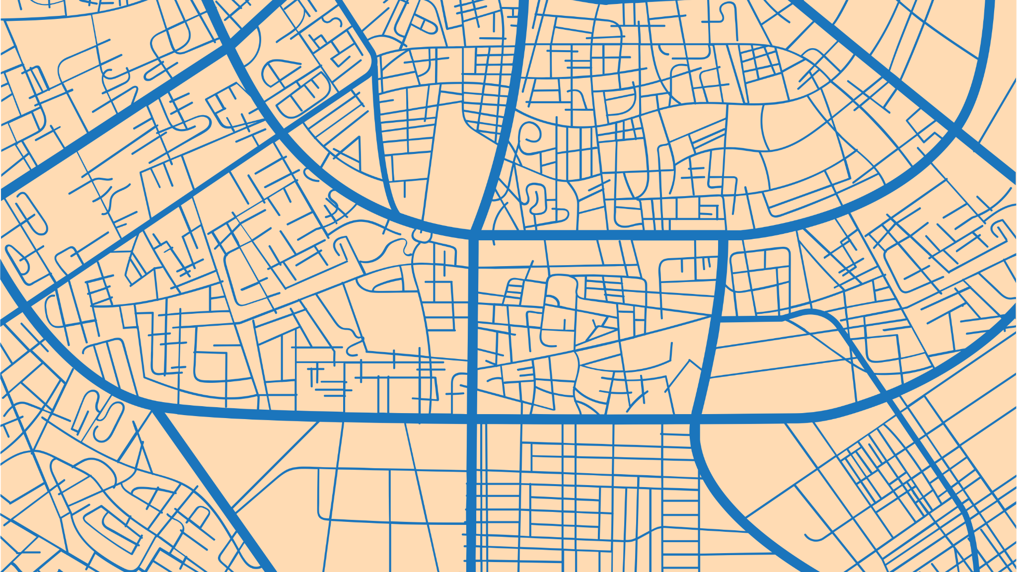
Thank you!
Notes:
That’s the end of our presentation. Thank you!

